Slide 1

Code to Cloud Workshop

Slide 2
Agenda of the day
Introduction
Workshop Introduction & Learning Objectives
Modules Description
Workshop Setup & Prerequisite setup
Welcome to Fabrikam Medical
Module 0 – Design session & Presentations
Module 1 – Concepts & HandsOn
Learning Review
Module 2 – Concepts & HandsOn
Learning Review
Module 3 – Concepts & HandsOn
Learning Review

Slide 3
Code to Cloud Workshop - Introduction
This workshop focusses on the Code to Cloud journey.
Learning objectives:
Integration with Azure Boards
Working with GitHub Codespaces
GitHub Flow
GitHub Container Registry.
Using Docker and Docker compose
Deploy solution to Azure Web App with Containers
Using GitHub Actions
Using Azure DevOps pipelines.

Slide 4
Code to Cloud Workshop - Introduction
Each module is prefaced with a conceptual training video that can be viewed by students or presented by the proctor
Challenge based workshop with self-paced challenges that can be used to discover and experience the features and concepts
To reduce “copy-paste”, starter scripts via Pull Requests to use the GitHub Flow “in action”
Full solution scripts are provided on-demand via Pull Requests
Extensive Step by Step instructions in text and video

Slide 5

MODULE 0
INTRODUCTION

Slide 6
Module 0 - Introduction
To set the stage the students collaborate to use the different services of Azure, GitHub and Azure DevOps to design an architectural roadmap and DevOps implementation plan for Fabrikam Medical.

Slide 7
Module 0
As facilitator you can have them read the instructions or role-play the part of VP of Engineering at Fabrikam, Susan Withers.

Slide 8
MODULE 1
IMPROVING THE DEVELOPER WORKFLOW

Slide 9
Module 1 - Improving the Developer Workflow
In this module your students will learn to:
Create a backlog of work with Azure Boards and relate that to your code
Use Docker to containerize your code, to enable a consistent environment
Use the GitHub workflow to work together on the same codebase
Use Pull Requests to improve the quality of your code
Set up a Continuous Integration build to quickly get feedback
Use GitHub Security scanning tools to shift left security issues
Use Docker Compose to create an environment that consists of multiple components

Slide 10
Module 1 – Trainer Materials
Concept presentation and/or video, explaining
Introduction to GitHub Codespaces
Introduction to Azure Boards and GitHub
Visual Studio Code
GitHub Flow
Testing Locally
Docker for a local production-like environment
Pull-Requests
GitHub Actions
GitHub Packages
Security Scanning
Azure Pipelines
7 Challenges

Slide 11

MODULE 2
MOVING TO THE CLOUD

Slide 12
Module 2 - Moving to the Cloud
In this module your students will learn to:
Use Infrastructure as Code to set up idempotent infrastructure in the cloud
Set up a resource group in Azure and assign permissions
Set up a CosmosDB via automation scripts
Set up an Azure Web App that runs a multi-container application via automation scripts
Set up a pipeline that deploys the infrastructure on demand

Slide 13
Module 2 – Trainer Materials
Concept presentation and/or video, explaining
Infrastructure as Code
Azure Fundamentals
Azure Web Apps
2 Challenges

Slide 14

MODULE 3
CLOSING THE FEEDBACK LOOP

Slide 15
Module 1 - Improving the Developer Workflow
In this module your students will learn to:
Implement Application Insights in the application
Monitor the containers and the platform
Implement Continuous Delivery in GitHub Actions
Set up a CI/CD pipeline with Azure DevOps to automatically deploy containers
Set up an manual and automatic approval gate in the release pipeline, to control the release of new versions

Slide 16
Module 1 – Trainer Materials
Concept presentation and/or video, explaining
Application Insights
Azure Pipelines - Basics
Azure Pipelines - Advanced: Stages, Environments & Checks
4 Challenges

Slide 17
BEFORE YOU START
PREREQUISITE SETUP

Slide 18
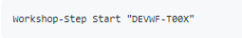
Prerequisite Setup
Students use the CodeToCloud-Workshop-Students to go through content
Students clone the CodeToCloud-Source Repository for sources
In the CodeToCloud-Source create a GitHub Codespace
Set up workshop scripts
Powershell profile with variables
GitHub and AzDo Personal Access Tokens
Setup Script to create settings file to execute start and solutions scripts

Slide 19
HOW TO DO CHALLENGES

Slide 20
STORYLINE
WELCOME TO FABRIKAM MEDICAL

Slide 21

Fabrikam Medical
Fabrikam Medical Conferences provides conference web site services tailored to the medical community. They started out 10 years ago building a few conference sites for a small conference organizer. Since then, word of mouth has spread, and Fabrikam Medical Conferences is now a well-known industry brand. They currently handle over 100 conferences per year and growing.
The VP of Engineering at Fabrikam, Susan Withers, has a team of 12 developers who handle all aspects of development, testing, deployment, and operational management of their customer sites. Due to customer demands, they have issues with the efficiency and reliability the conference websites. This mainly caused by an inefficient development and operations workflow.
In the current situation, the conference sites are hosted on-premises with the following topology and platform implementation:
The conference web sites are built with the MEAN stack (Mongo, Express, Angular, Node.js).
Web sites and APIs are hosted on Linux machines.
MongoDB is also running on a separate cluster of Linux machines.

Slide 22
Fabrikam Medical - Goals
Improve the overall architecture
Improve the Development workflow
Improve the quality and maintainability of the code base
Improve the DevOps lifecycle.
Increase visibility into system operations and health.

Slide 23
Fabrikam Medical - Goals
Improve the overall architecture
Improve the Development workflow
Improve the quality and maintainability of the code base
Improve the DevOps lifecycle.
Increase visibility into system operations and health.

Slide 24
Fabrikam Medical - Needs
Reduce the overhead in time, complexity, and cost for deploying new conference tenants.
Improve the reliability of conference tenant updates.
Choose a suitable platform for their conference solution.
Make it easy to deploy and manage infrastructure.
Provide tooling to help them with monitoring and managing container health and security.
Make it easier to manage the variable scale requirements of the different tenants, so that they no longer have to allocate tenants to a specific load balanced set of machines.
Provide a vendor neutral solution so that a specific on-premises or cloud environment does not become a new dependency.
Start with Azure since that is already in their Enterprise Agreement
Migrate data from MongoDB on-premises to CosmosDB with the least change possible to the application code.
Use Git repositories for source control and integrate into a CICD workflow.
Embed code review and security scanning in to the development workflow
Solution that does not incur a direct vendor-lock in
As much re-use of existing code base
Complete an implementation of the proposed solution for a single tenant to train the team and perfect the process.

Slide 25
MODULE 0
HANDS-ON

Slide 26
Module 0 - Introduction
Design Cloud Architecture and DevOps Roadmap for Fabrikam Medical Conferences
Present the solution to the Fabrikam Medical Conferences Board

Slide 27







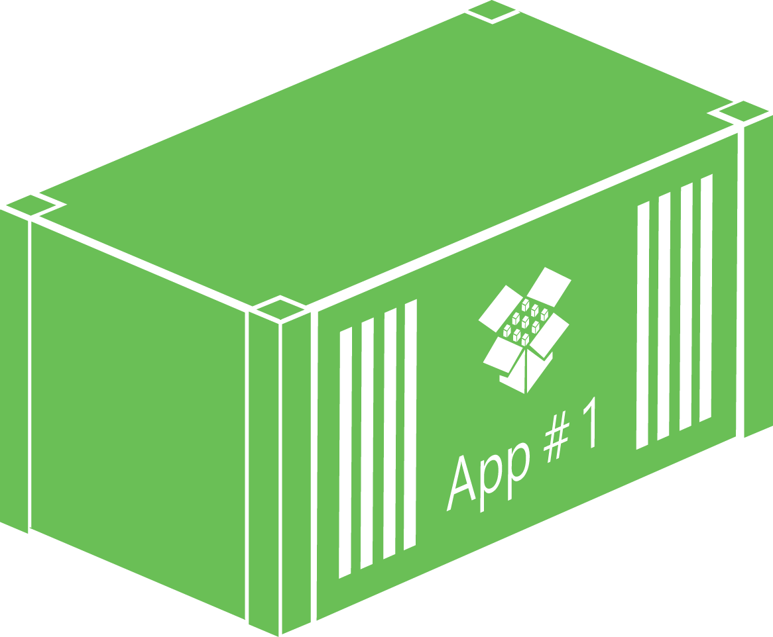
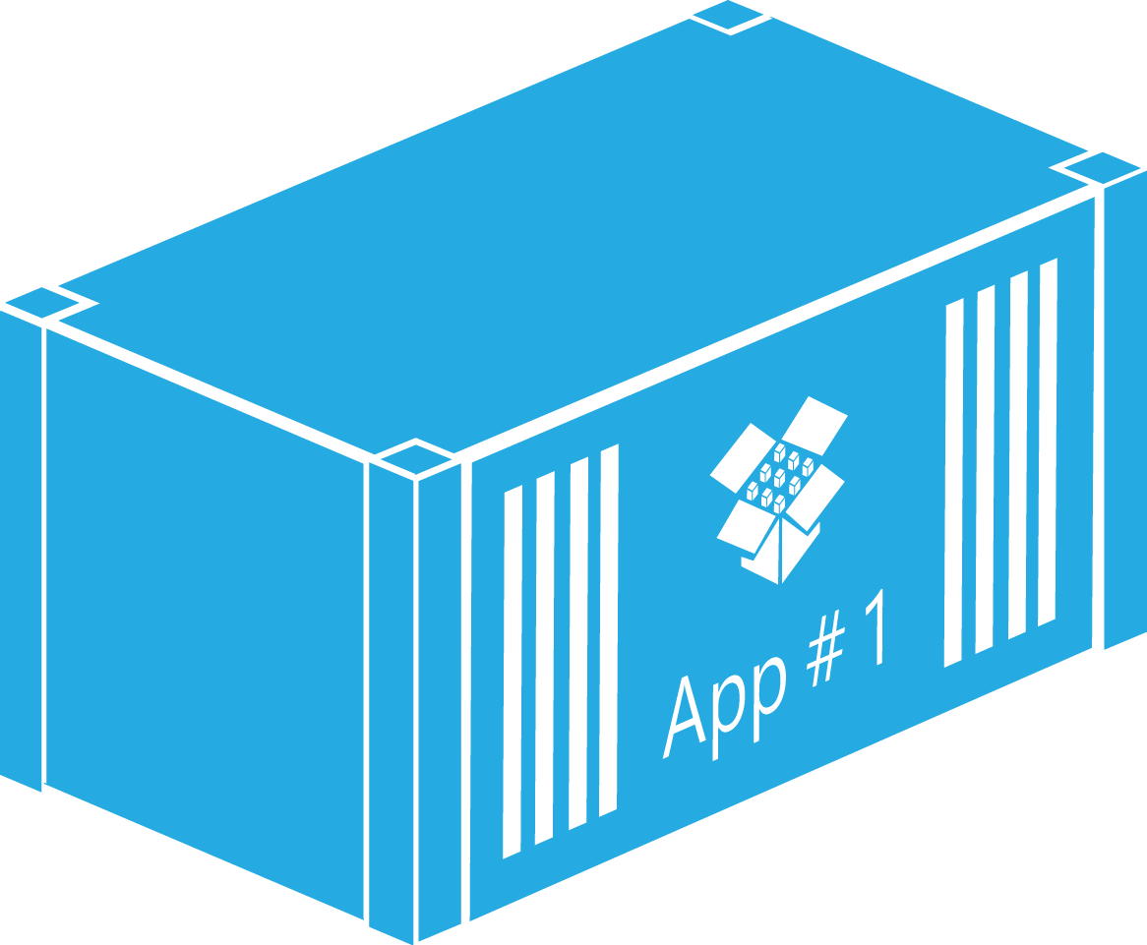
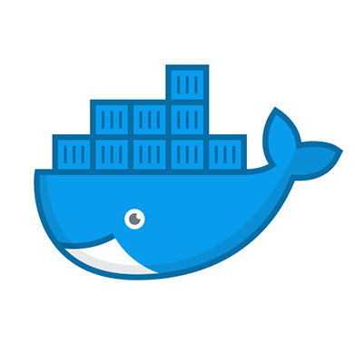
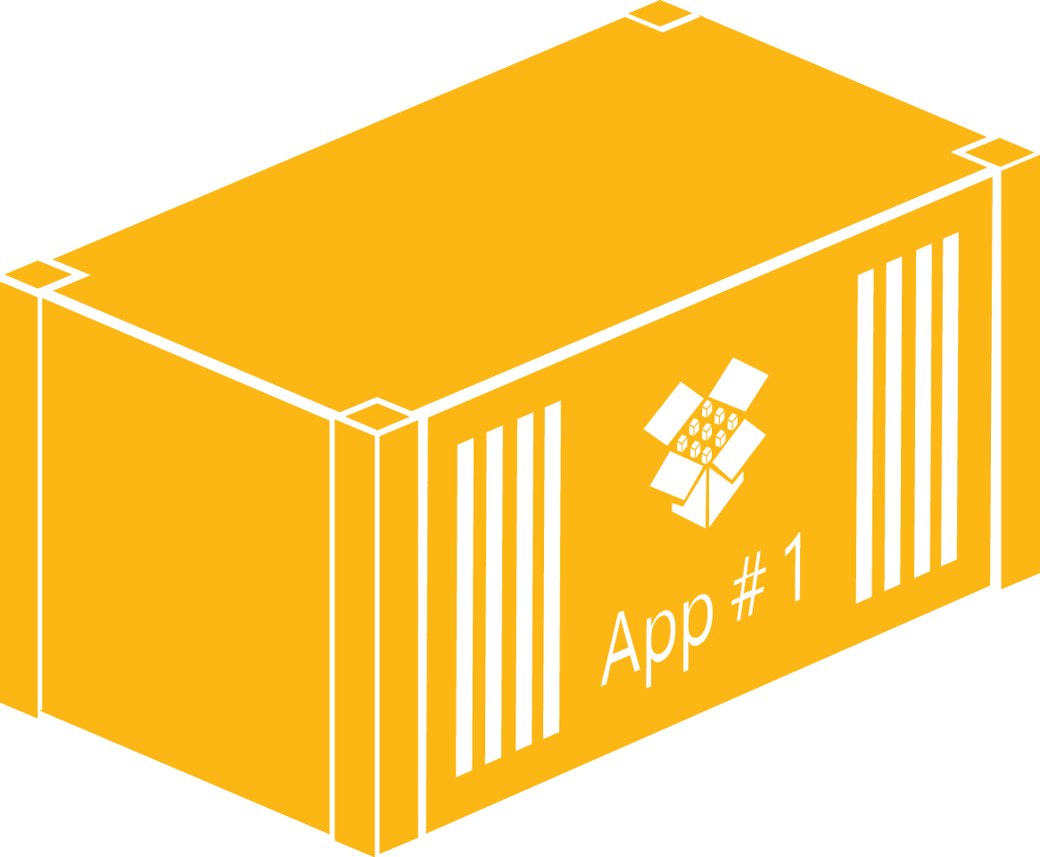

Proposed Architecture - GH Actions
Resource Group
Deploy Infrastructure
App Service Plan
CosmosDB
Web app
Application Insights
Sources
Build and
Push Containers
Github Container Registry
Pull Containers
Push Containers

Slide 28

Proposed Architecture - Azure DevOps
Resource Group
Deploy Infrastructure
App Service Plan
CosmosDB
Web app
Application Insights
Sources
Build and
Push Containers
Github Container Registry
Pull Containers
Push Containers

Slide 29
MODULE 1
CONCEPT PRESENTATION

Slide 30
MODULE 1
HANDS-ON

Slide 31
Module 1 – Improving Developer Workflow
DEVWF-T001 Get started with the work and create visibility
DEVWF-T002 Running the application locally
DEVWF-T003 Containerize the Application
DEVWF-T004 Optimize containers with a multi staged Docker File
DEVWF-T005 Catching Security Vulnerabilities
DEVWF-T006 Setting up a local infrastructure
DEVWF-T007 Set up Continuous Integration to push container images to GitHub Registry

Slide 32
MODULE 2
CONCEPT PRESENTATION

Slide 33
MODULE 2
HANDS-ON

Slide 34
Module 2 – Moving to the Cloud
MOVECLOUD-T001 Setting up a cloud infrastructure
MOVECLOUD-T002 Running containers in an Azure WebApp

Slide 35
MODULE 3
CONCEPT PRESENTATION

Slide 36
MODULE 3
HANDS-ON

Slide 37
Module 3 – Closing the feedback loop
CLOSELOOP-T001 Getting insights in to your application
CLOSELOOP-T002 Setup Continuous Deployment with GitHub Actions
CLOSELOOP-T003 Increase control with Azure DevOps CI/CD
CLOSELOOP-T004 Deploy latest validated version with automated approvals

